Slide 1



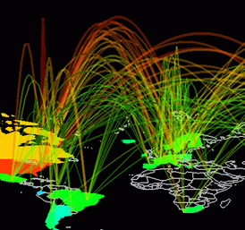
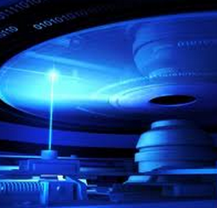


The International Year of Light and Light-based Technologies
2015
Health
Communications
Economy
Environment
Social

Slide 2


Background
With endorsement by the UNESCO Executive Board in November 2012, leading scientists were invited to present the case for an International Year of Light at the United Nations General Assembly in May 2013.
A resolution has now been adopted at the United Nations General Assembly, and so 2015 will be the International Year of Light

Slide 3
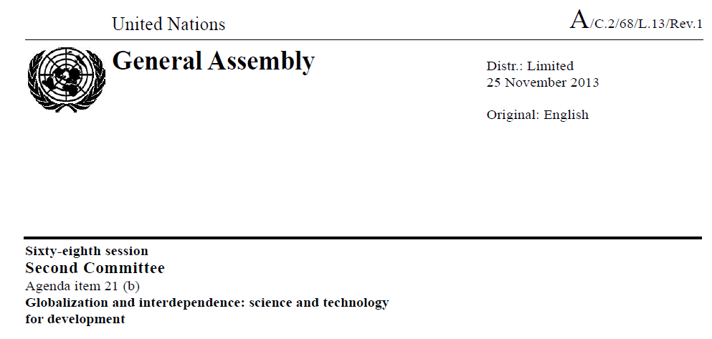
International Year of Light
The resolution was adopted in Committee on 3 December 2013 with many co-sponsors, and subsequently adopted at the General Assembly by unanimous acclamation.
Argentina, Australia, Azerbaijan, Bosnia and Herzegovina, Chile, China, Colombia, Cuba, Dominican Republic, Ecuador, France, Ghana, Guinea, Haiti, Honduras, Israel, Italy, Japan, Mauritius, Mexico, Montenegro, Morocco, Nepal, New Zealand, Nicaragua, Palau, Republic of Korea, Russian Federation, Somalia, Spain, Sri Lanka, Tunisia, Turkey, Ukraine and United States of America

Slide 4
Overview and Aims
The International Year of Light is a cross-disciplinary educational and outreach project with more than 100 partners from over 85 countries
Why Light?
The science and applications of light creates revolutionary - but often unseen - technologies that directly improve quality of life worldwide
Health
Communications
Economy
Environment
Social

Slide 5
Overview and Aims
The International Year of Light is a cross-disciplinary educational and outreach project with more than 100 partners from over 85 countries
Why Light?
Light-based technology is a major economic driver with potential to revolutionize the 21st century [as electronics did in the 20th century]
Health
Communications
Economy
Environment
Social

Slide 6
Overview and Aims
The International Year of Light is a cross-disciplinary educational and outreach project with more than 100 partners from over 85 countries
Why Light?
The Proclamation of an International Year of Light will ensure the importance of light and its potential applications are appreciated by all
Health
Communications
Economy
Environment
Social

Slide 7
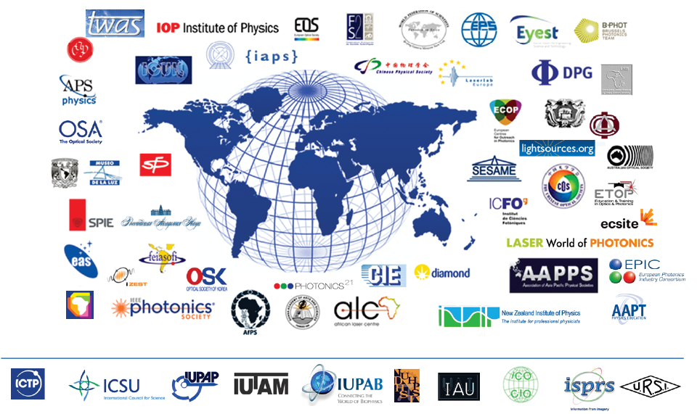










100+ partners from 85 countries

Slide 8
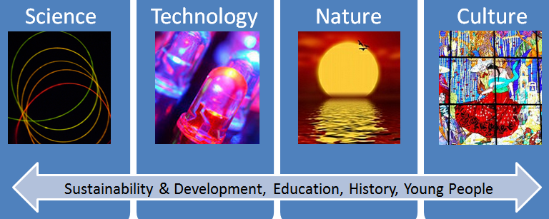
Opportunity for the future
The Proclamation of an International Year of Light is a tremendous opportunity to coordinate international activities and promote new initiatives to support the revolutionary potential of light technologies
How?
Clear themes, cross-cutting activities, communication with the public

Slide 9




Light has an inclusive identity for all
Origin of Life
Sustainability
Culture
Universal
Flags
International
Inclusive
Colour
Spectrum, Science
Art and Culture
Education

Slide 10
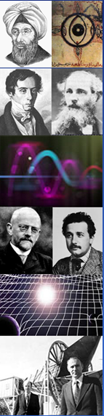

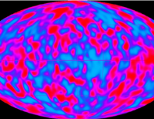
2015 celebrates major anniversaries
1015 Ibn Al Haythem Book of Optics
1815 Fresnel and the wave nature of light
1865 Maxwell and electromagnetic waves
1915 General relativity – light in space and time
1965 Cosmic microwave background, Charles Kao
and optical fibre technology

Slide 11

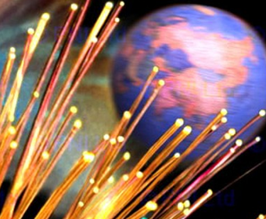
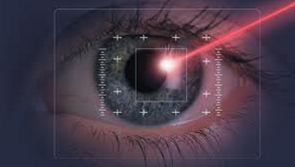
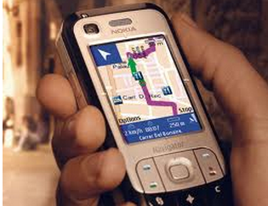
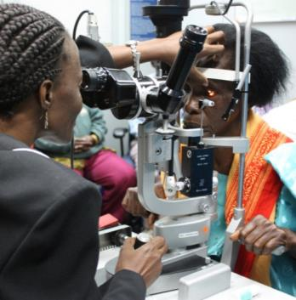
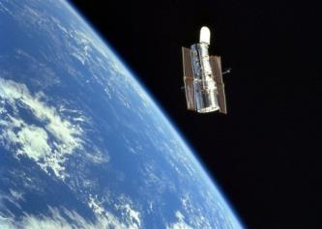
Activities are very broad - science…
Origin of Life
Healthcare
Communications & GPS
Optical Instruments
The Universe

Slide 12

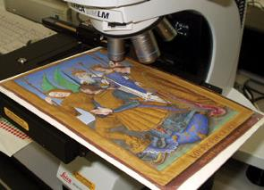


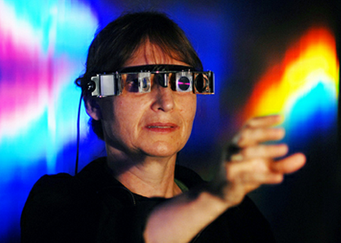

… and more than science
Cultural Heritage
Education for All
Nature
Light and Art

Slide 13

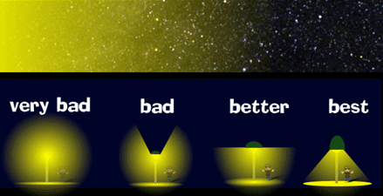

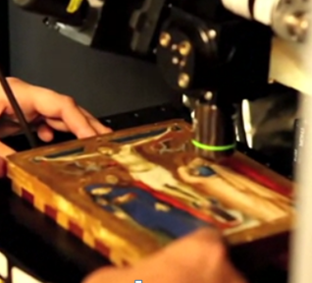

Cultural Heritage
Smart lighting can both highlight culture and reduce light pollution
Optical technologies give new impetus - from art to archaeology
Laser imaging
at Caracol, Mexico

Slide 14
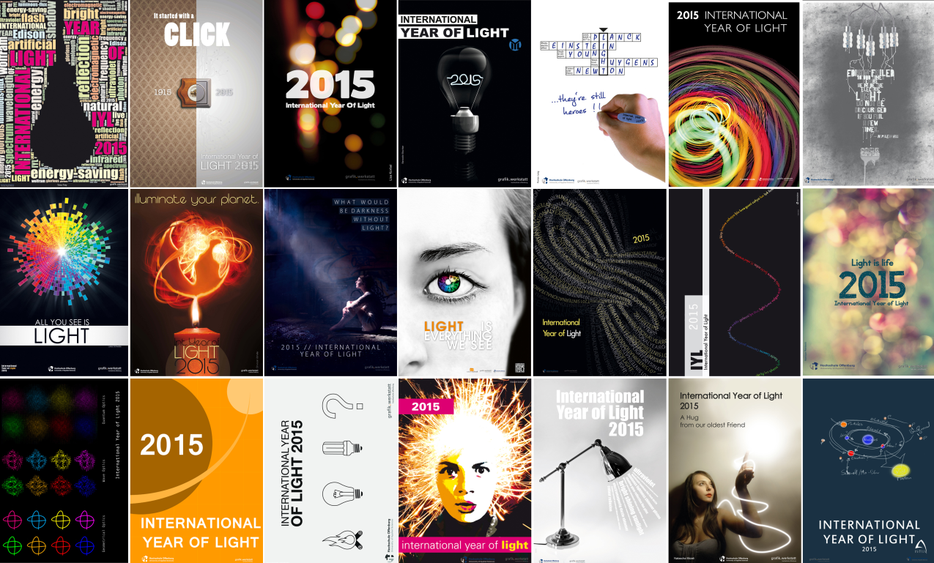
Natural connections with art

Slide 15
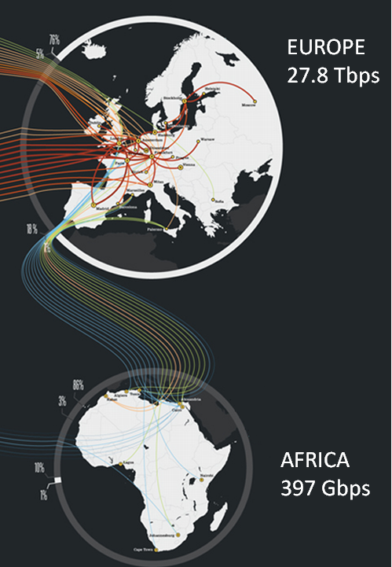
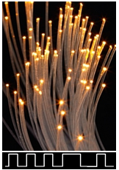

Highlighting impact on development
Light technology is at the heart of the Internet and communications
Raising awareness of disparities in information access is essential for future development of society

Slide 16
Conclusions
Why light and optics?
Light is central to science, technology, art and culture
Light can promote education at all levels
Light technology drives development
Why an International Year of Light?
The importance of light technology needs to be appreciated
International coordination will create durable programmes
We aim to inspire a new generation to study science through light
The 21st century is the Century of Light

